Slide 1

Sales Order Analysis: Data Analytics Project
Transforming raw transactional data into high-level business intelligence.

Slide 2

Project Overview
Optimize Operations
Integrate Python, SQL, and Power BI for comprehensive analysis.
Identify Trends
Uncover revenue trends, regional performance, and YoY growth.
Data-Driven Decisions
Support strategic decision-making with actionable insights.

Slide 3

Dataset Summary
Comprehensive sales dataset (orders.csv) with 9,994 records and 16 attributes.
Order & Geographic Data
Product & Financial Metrics
Order ID, Order Date, Ship Mode, Segment
Country, City, State, Region
Category, Sub-Category, Product ID
Cost Price, List Price, Quantity, Discount Percent

Slide 4


Calculated Fields & Analysis
Sale Price
Profit
Derived from list price and discount.
Key metric for product performance.
Revenue
Total sales generated.
These fields enable deep analysis of revenue trends, profitability, and seasonal behavior.

Slide 5




Tools & Technologies
Python
SQL
Power BI
Jupyter Notebook
Data loading, cleaning, EDA (Pandas, NumPy, Matplotlib/Seaborn).
Business analysis, advanced queries (PostgreSQL / MySQL / SQL Server).
Interactive dashboards, KPI reporting.
Analysis environment for iterative work.

Slide 6


Project Workflow: Data Preparation
Data Cleaning
Detect and fix errors, missing values
Feature Engineering
Data Ingestion
Collect raw sources into pipeline
Create predictive features for models
The raw data underwent a rigorous ETL process using Python for optimal analysis.

Slide 7

SQL-Based Business Analysis
Cleaned data migrated to SQL to solve critical business problems.
Revenue Leaders
Top 10 products by revenue.
Regional Performance
Top 5 selling products per region.
Time-Series Analysis
MoM growth comparison (2022 vs 2023).
Profit Growth
Sub-categories with highest profit growth.

Slide 8
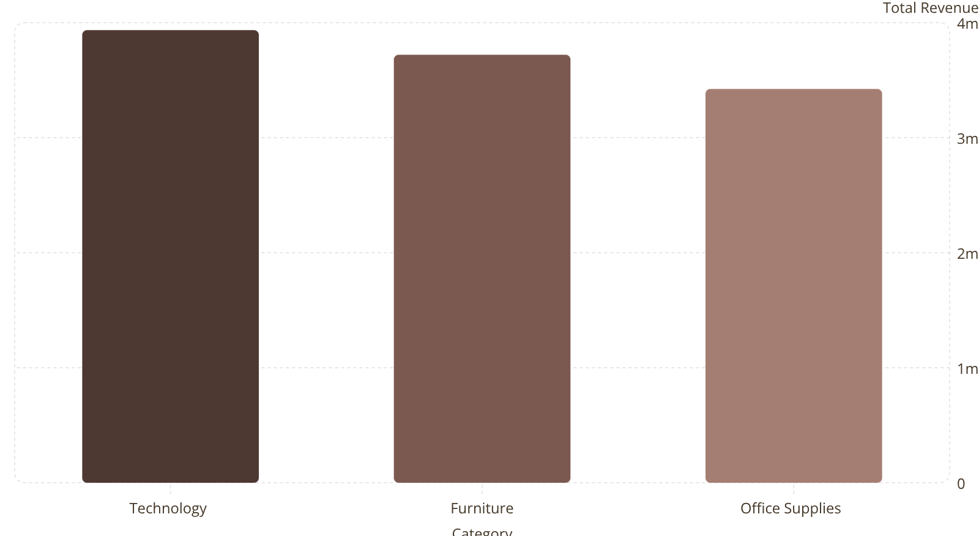
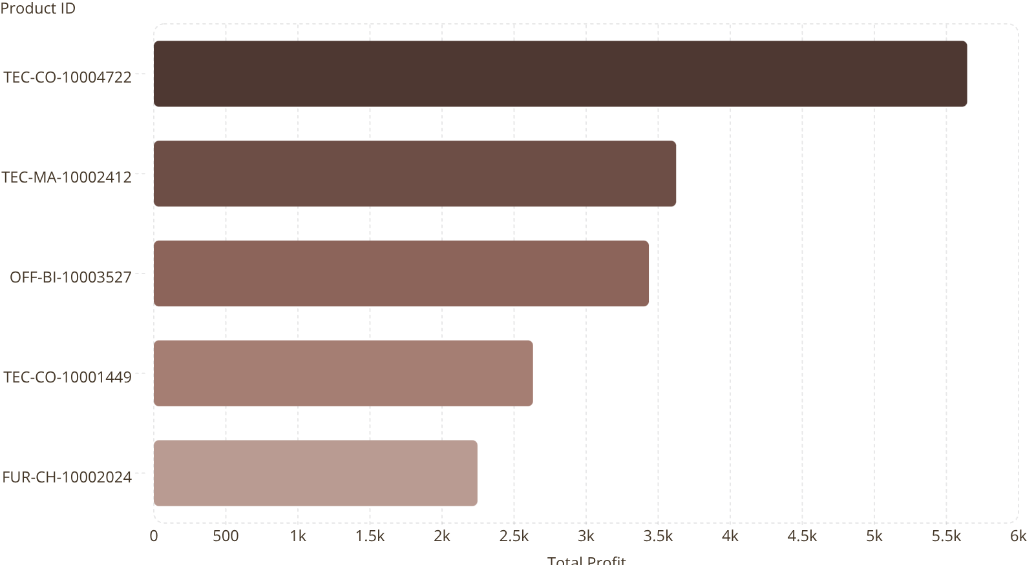
Key Findings: Revenue & Profit
Total Revenue by Category
Top 5 Profitable Products

Slide 9
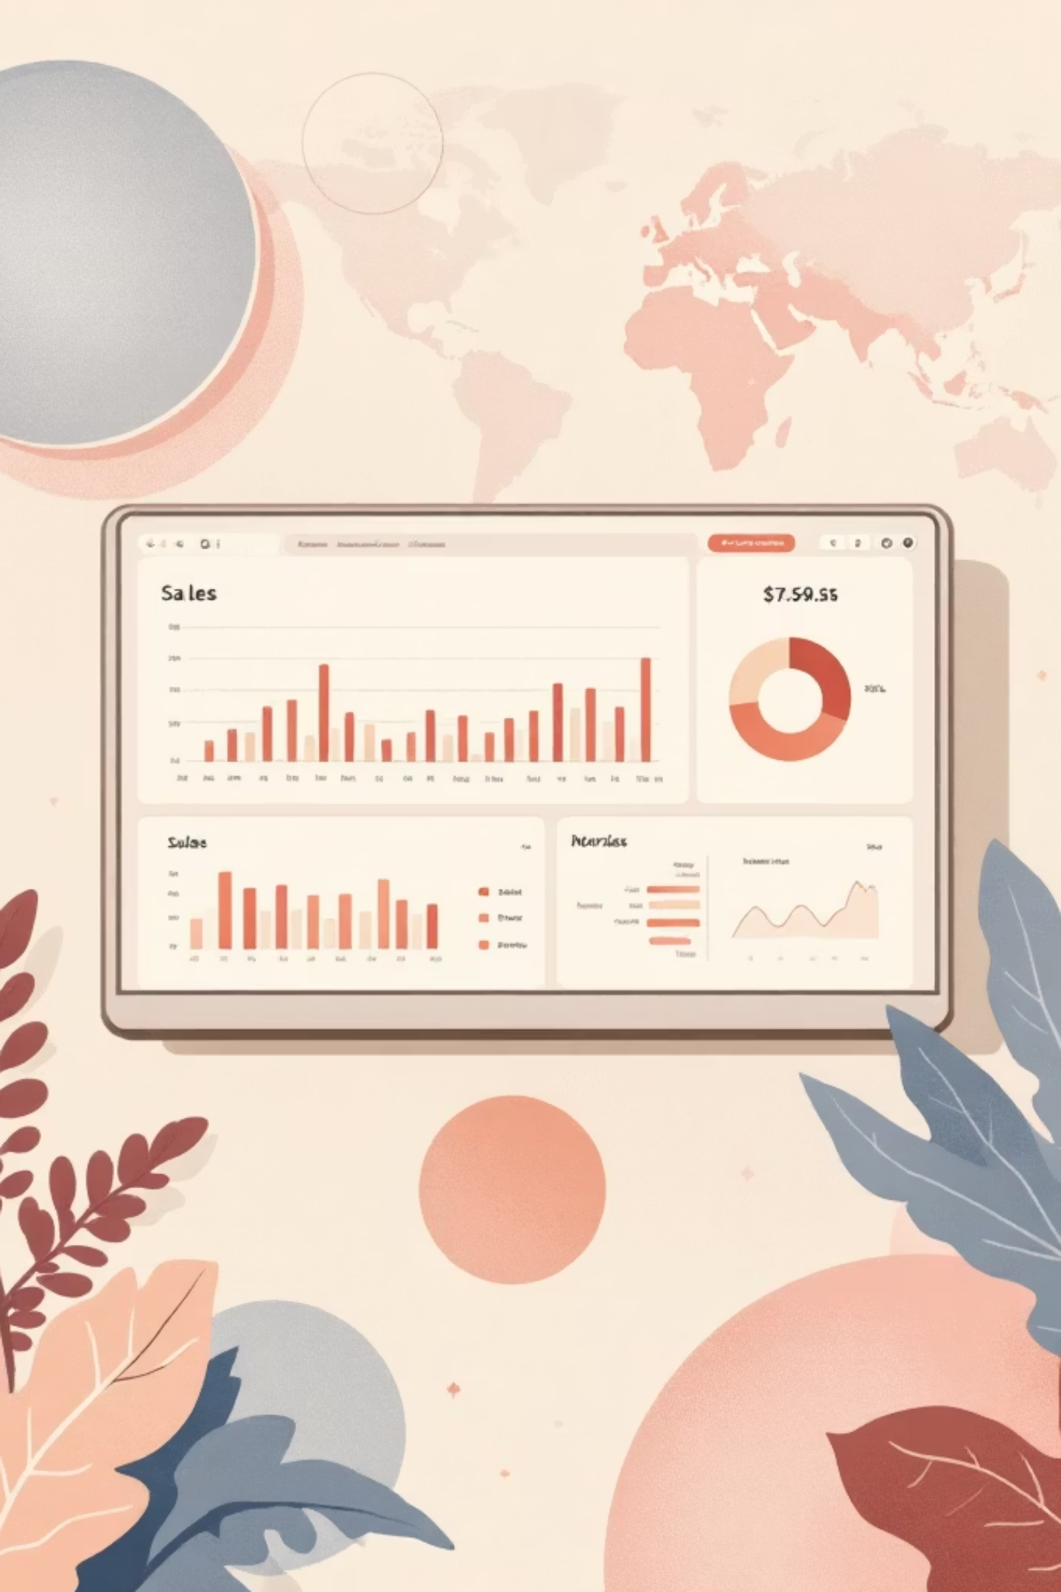
Power BI Dashboard Overview
Interactive dashboard for stakeholders to explore sales performance.
KPI Scorecard
Real-time tracking of Total Sales, Profit, Quantity Sold.
Category Drill-down
Compare performance across Furniture, Office Supplies, Technology.
Geographic Mapping
Visual representation of sales density across the US.

Slide 10

Key Results & Recommendations
High-Growth Sub-Categories
Profit Optimization
"Paper" had -3.81% growth. Review supplier costs or pricing strategies.
"Machines" showed 50.19% profit growth. Increase inventory and marketing.
Seasonal Strategy
Align marketing campaigns with historical sales peaks for each category.

